Slide 1
KeyD: secure key deduplication with
identity based broadcast encryption
Areti Durgamanikanta
MCA 2nd year
RegdNo:XXXXX
Guided by Mr P.W. Syam babu,
Head of the Department

Slide 2
Contents
ABSTRACT
EXISTING SYSTEM
PROPOSED SYSTEM
MODULES
FUNCTIONAL REQUIREMENTS
NON FUNCTIONAL REQUIREMENTS
H/W & S/W REQUIREMENTS
UML DIAGRAMS
TECHNOLOGY
SCREENSHOTS
CONCLUSION

Slide 3
Abstract
Deduplication, which can save storage cost by enabling us to store only one copy of identical data, becomes unprecedentedly significant with the dramatic increase in data stored in the cloud. For the purpose of ensuring data confidentiality, they are usually encrypted before outsourced. Traditional encryption will inevitably result in multiple different ciphertexts produced from the same plaintext by different users’ secret keys, which hinders data deduplication. Convergent encryption makes deduplication possible since it naturally encrypts the same plaintexts into the same ciphertexts. One attendant problem is how to reliably and effectively manage a huge number of convergent keys. Several deduplication schemes have been proposed to deal with the convergent key management problem.

Slide 4
However, they either need to introduce key management servers or require interaction between data owners. In this paper, we design a novel client-side deduplication protocol named KeyD without such an independent key management server by utilizing the identity-based broadcast encryption (IBBE) technique. Users only interact with the cloud service provider (CSP) during the process of data upload and download.

Slide 5
Existing System
It employs the Ramp secret sharing scheme (RSSS) to construct secret shares for the convergent keys and distribute them across multiple independent Key Management Cloud Service Providers (KMCSPs). To recover data copies, a user must access a minimum number of key servers through authentication and obtain the secret shares to reconstruct the convergent keys. The premise of the scheme security is that the number of colluded KM-CSPs is not more than a predefined threshold, such that a convergent key cannot be guessed by the colluded KM-CSPs.
We propose a session-keybased convergent key management scheme and an improved version. A trustable gateway is needed to check the duplication and buffer the new data blocks for periodically uploading them to the cloud storage server (CSS). As far as we know, there is no deduplication scheme that can effectively manage convergent keys, without the aid of additional independent key management servers or other trusted parties like Gateway.

Slide 6
Disadvantages of existing System
Storing convergent keys locally is quite a heavy burden for users, but encrypting them with different master keys and outsourcing them will lead to the duplication of encrypted convergent keys on the server side.
Involves complex interactions between clients for key sharing, which violates the ownership privacy during the data deduplication. Therefore, designing a secure and effective client-side deduplication scheme without other independent servers or trusted third parties is still an open problem.

Slide 7
Proposed System
In this paper, we construct a secure deduplication scheme to manage convergent keys. We propose a novel client-side deduplication scheme. Specifically, we make a combination of convergent encryption (CE) and ID-based broadcast encryption (IBBE) to achieve secure and efficient convergent key management, without introducing any other independent key management servers or trusted third parties. Security analysis demonstrates that our scheme ensures the confidentiality of data files and the security of convergent keys.

Slide 8
Advantages of Proposed System
A comprehensive performance comparison between KeyD and several present works is given, showing that our scheme makes a better tradeoff among the storage cost, communication overhead and computation overhead.
Fully protected against outside attackers and the CSP.
No Additional Independent Servers or Trusted Third Parties.
Confidentiality of Data.
Semantic Security of Convergent Keys.

Slide 9
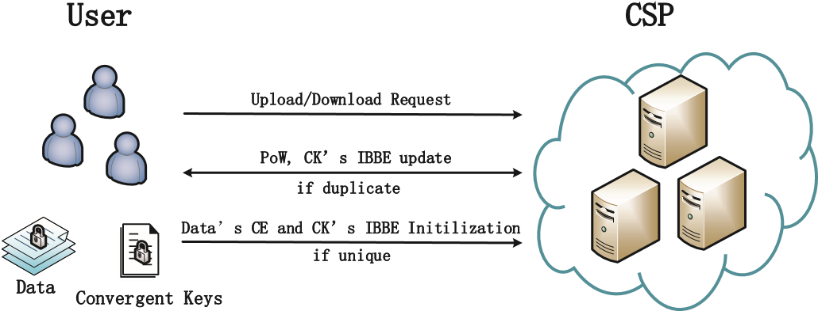
System Architecture

Slide 10

Modules
Data Owner
CSP(Cloud service provider)
TPA(Third Party Administrator)
Data User

Slide 11

Functional Requirements
1. Key Deduplication:
This requirement involves implementing algorithms to identify and eliminate duplicate keys to optimize storage space usage. It ensures that the system efficiently manages keys without unnecessary duplication, reducing storage overhead.
2. Identity-Based Encryption:
Data owners should be able to encrypt data using their identities as keys. This requirement ensures that data encryption is tied to user identities, simplifying key management and access control.

Slide 12
3. Broadcast Encryption:
This requirement enables encrypted data to be broadcasted to multiple users efficiently. Authorized users should be able to decrypt the data using their private keys, ensuring secure and scalable distribution of encrypted content.
4. Secure Communication:
All communication between users and the server should be encrypted using secure protocols. Encryption and decryption operations should be performed securely to prevent unauthorized access to sensitive information during transmission.

Slide 13

6. Key Management:
Encryption keys should be generated securely and stored in a protected manner. Key distribution should be handled securely to prevent unauthorized access to keys, ensuring the confidentiality and integrity of encrypted data.
7. Logging and Auditing:
The system should log key usage, access attempts, and other relevant activities for auditing purposes. Logs should be accessible only to authorized administrators, enabling accountability and compliance with security policies.

Slide 14
Non-Functional Requirements
1. Security
2. Performance
3. Scalability
4. Reliability
5. Usability
6. Interoperability
7. Compliance
8. Maintainability
9. Performance
10. Accessibility

Slide 15

Hardware Requirements
Hard disk : 120GB
Monitor : 15” LED
RAM : 1GB
Processor : Pentium Dual Core
Input devices : Key Board, Mouse

Slide 16
Software Requirements
Operating Systems : WINDOWS 7/10/11
Technologies Used : JAVA, JDBC, Oracle 10g
Tool : Netbeans 8.2
Front End : Java Swing and Java AWT
Back End : Oracle 11g

Slide 17
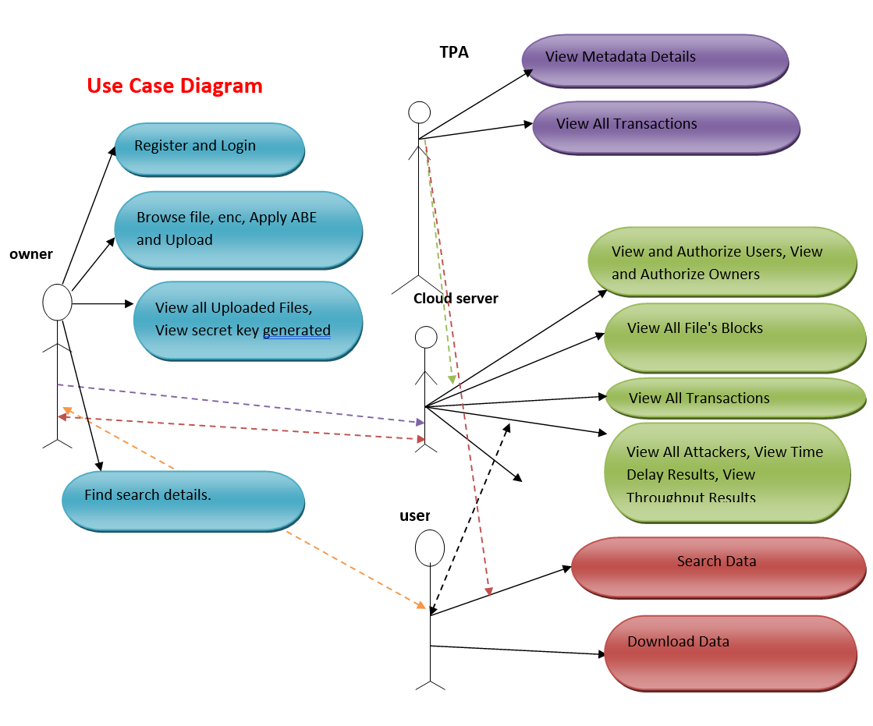
UML Diagrams
Use case diagram

Slide 18
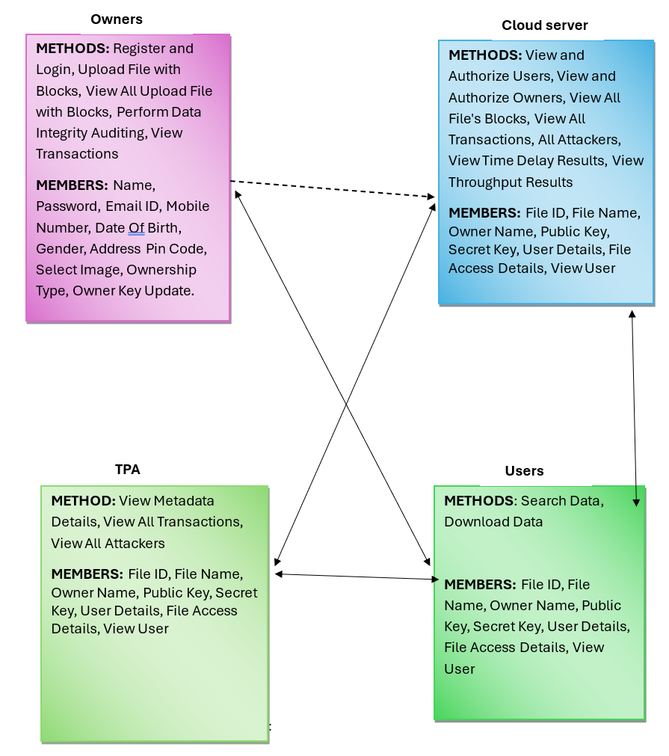
Class diagram

Slide 19
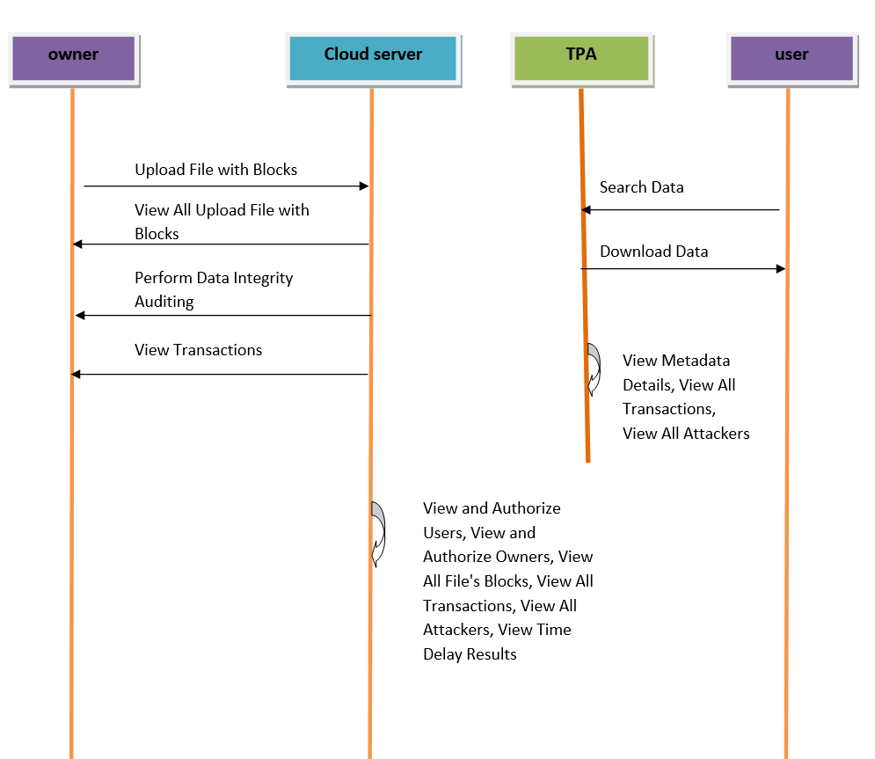
Sequence diagram

Slide 20
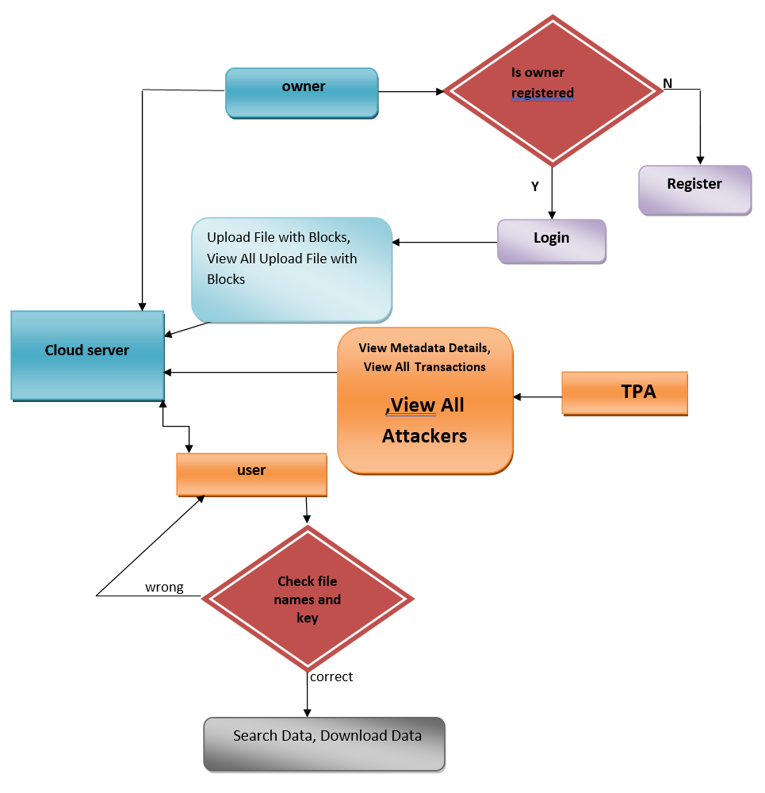
Activity diagram

Slide 21
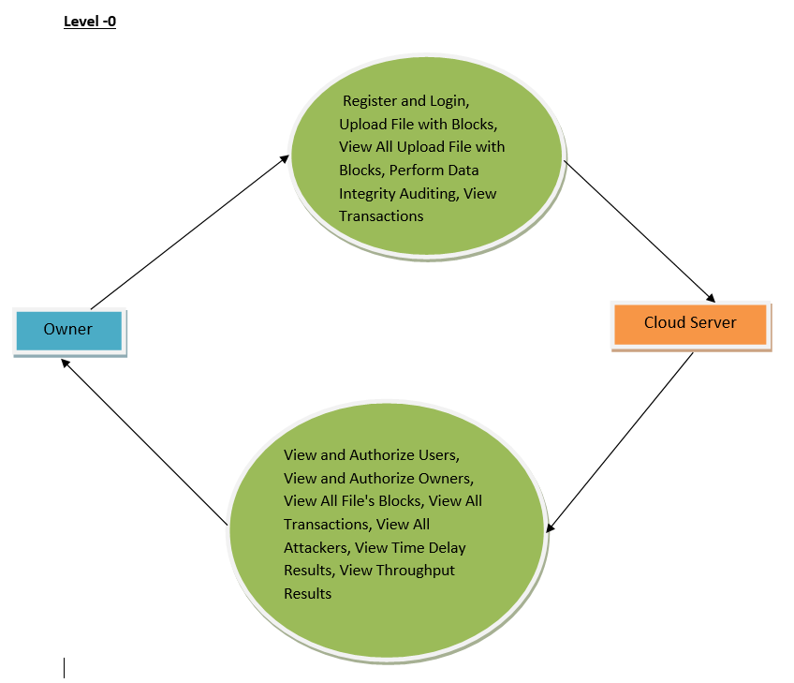
State machine diagram

Slide 22
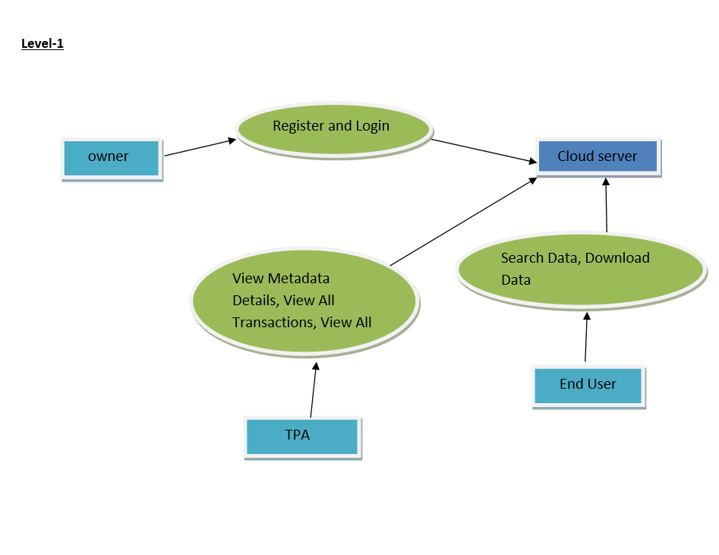
State machine diagram

Slide 23

Technology
The Java Programming Language
The Java programming language is a high-level language that can be characterized by all of the following buzzwords:
Simple
Architecture neutral
Object oriented
Portable
Distributed
High performance
Interpreted
Multithreaded
Robust
Dynamic
Secure

Slide 24
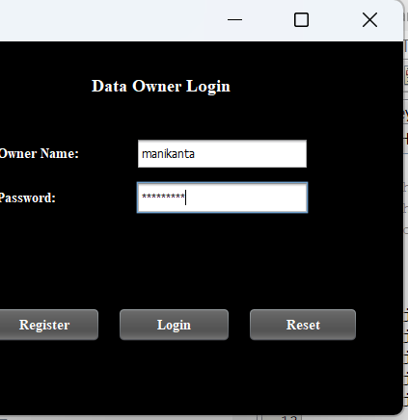
Data Owner Login

Slide 25
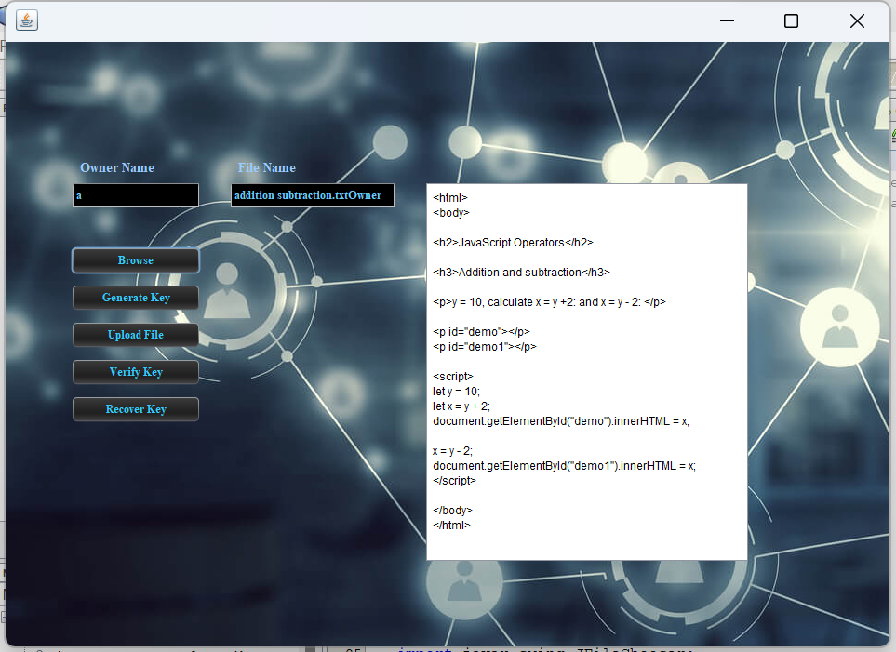
Data Owner

Slide 26
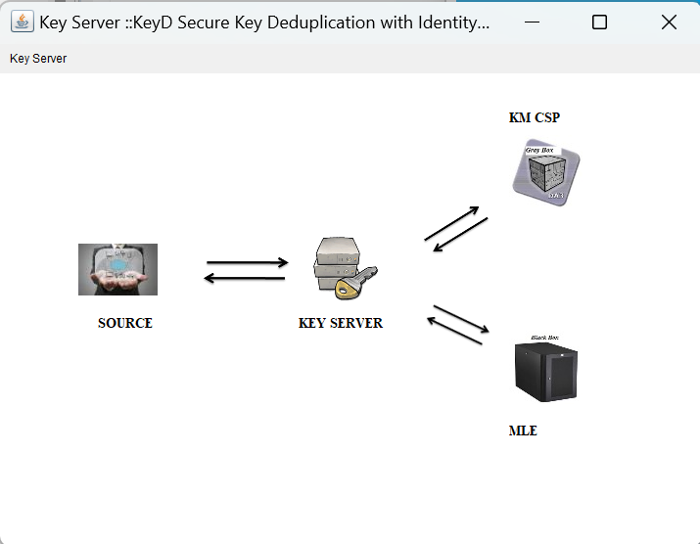
Key Server

Slide 27
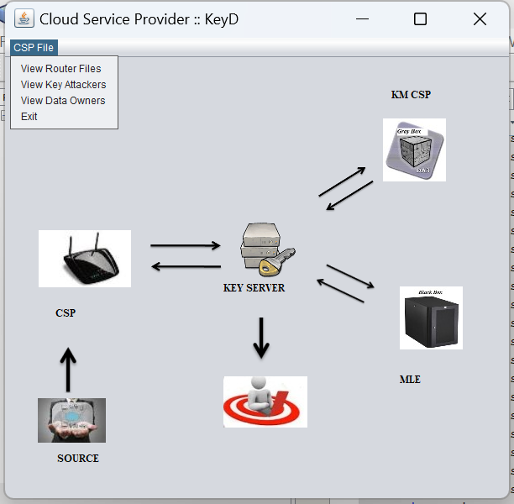
Cloud Service Provider

Slide 28
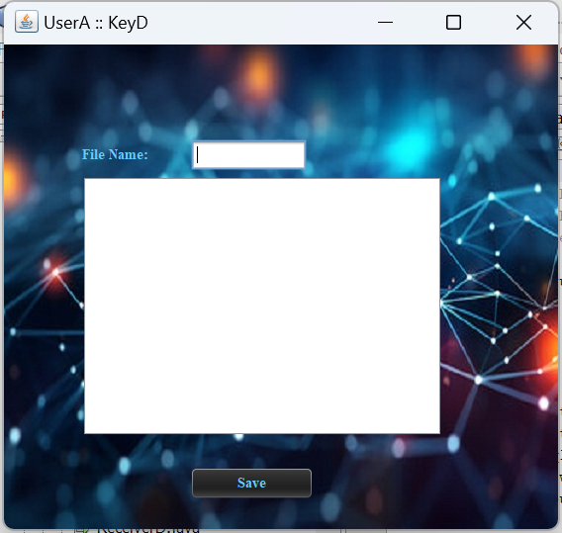
User

Slide 29
Conclusion
In this paper, we propose a secure client-side deduplication scheme KeyD to effectively manage convergent keys. Data deduplication in our design is achieved by interactions between data owners and the Cloud Service Provider (CSP), without participation of other trusted third parties or Key Management Cloud Service Providers. The security analysis shows that our KeyD ensures the confidentiality of data and security of convergent keys, and well protects the user ownership privacy at the same time. Experimental results demonstrate that the security of our scheme is not at the expense of the performance. For our future work, we will try to seek ways to protect the identity privacy of data owners, which is not considered in our scheme.

Slide 30
Thank you

